Slide 1

TuneMe – Playlist Generator App
CS 5001 - Senior Design 1 | Fall 2022 | Zaina Qasim

Slide 2
Project Members and Advisor
Member(s)
Zaina Qasim
qasimza@mail.uc.edu
Faculty Advisor
Fred Annexstein
fred.annexstein@uc.edu

Slide 3
Project Abstract
The most popular music-listening apps (and recommendation engines) are Apple Music and Spotify. The former uses a user's listening history, genres and artists selected at the time of creating their profile, as well as similarity to other users' preferences to recommend music while the latter breaks down a song into its rhythm and structure. However, neither app has any features for users to input how they define similarity – whether it is instrumentation, genre, etc. or a combination of such criteria. Thus, this project aims to improve user experience by taking into account their definition of similarity while curating suggestions.

Slide 4
User Stories
As someone who is new to classic rock music (60s, 70s, 80s) I want to filter through music by genre and era so that I can discover similar artists/music that I might not know of.
As someone going through a tough time, I want to find music that is lyrically similar to my struggles so that I can find songs that resonate with what I am feeling.
As a Zumba Instructor, I want to create playlists that are filtered by rhythm/beat so that I have music for the differently paced dance steps that I want to teach.
As someone planning a 70s throwback party, I want to filter music by era, occassion and popularity (by age group) so that I can create a playlist of the most popular dance songs amongst college students in the 70s.
As a Spotify user, I want to be able to export my recommended playlist to the app so I can continue to use a platform that I am more familiar with.

Slide 5
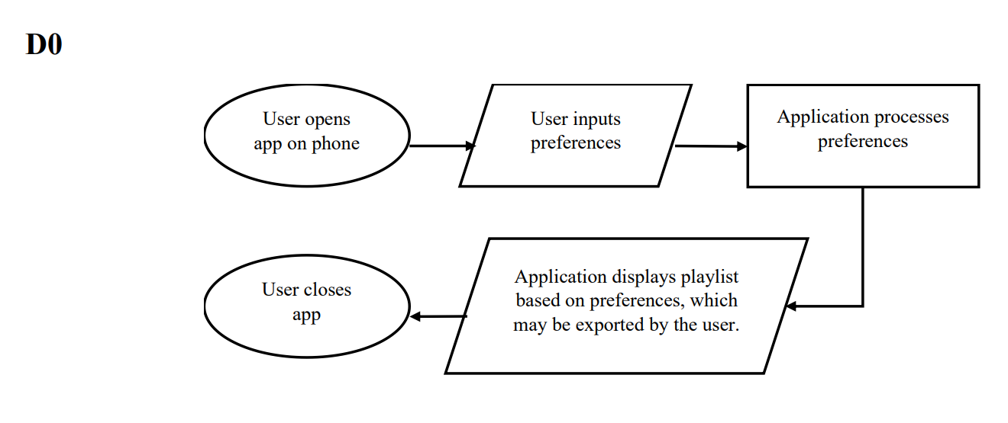
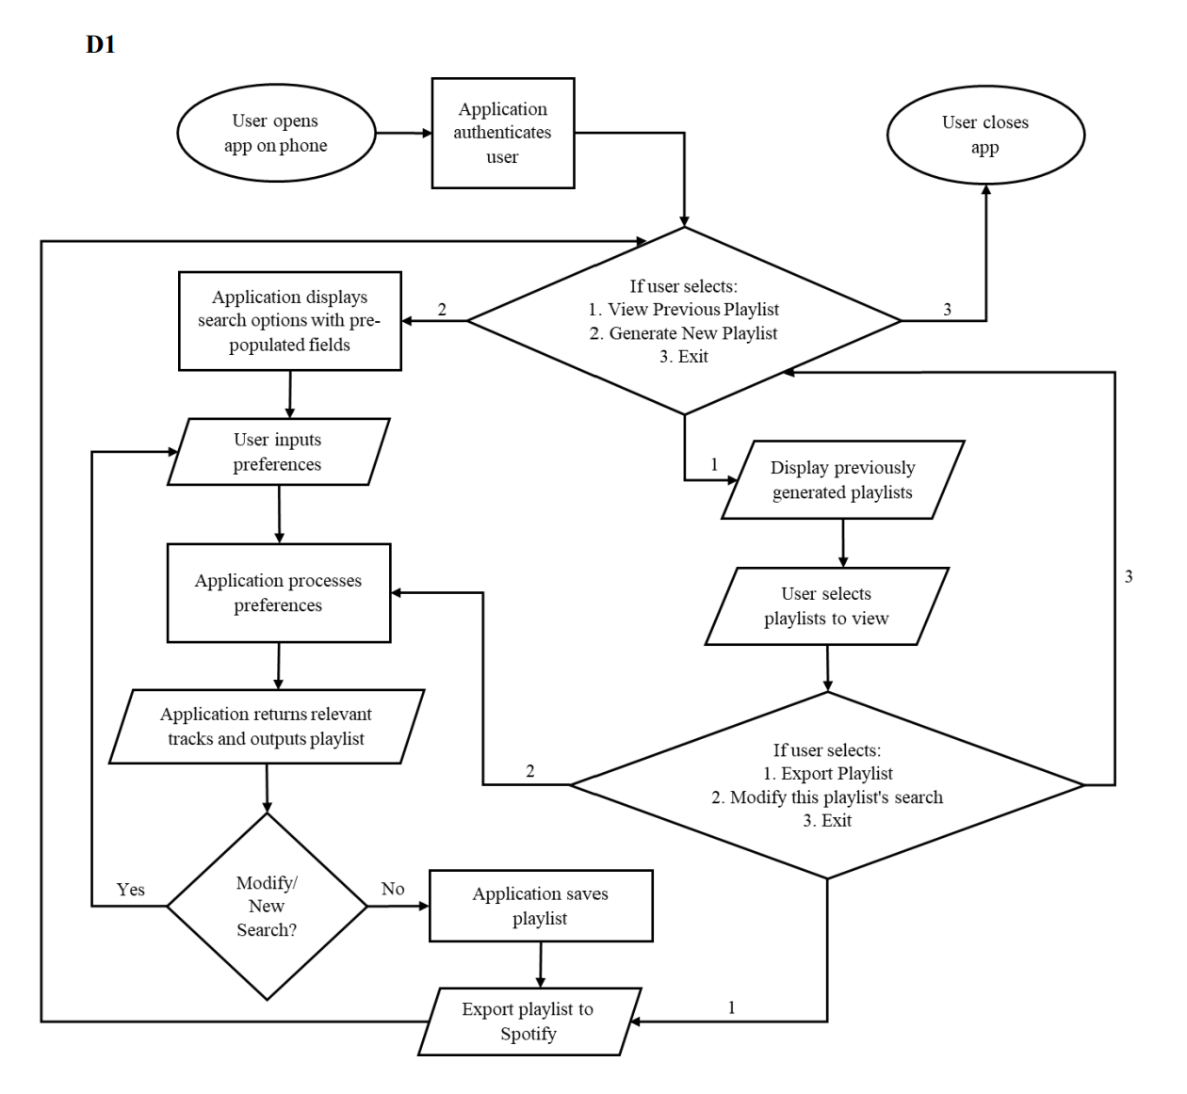
Design Diagrams

Slide 6
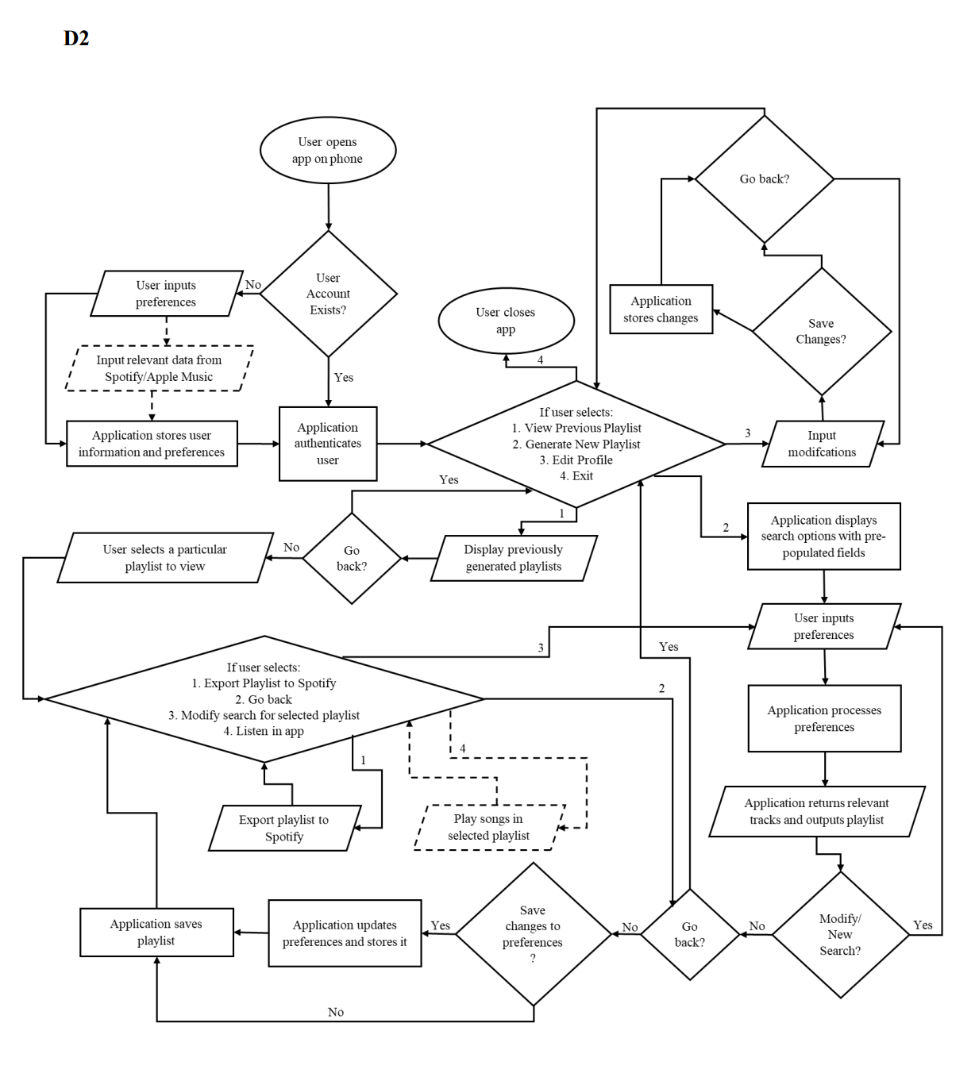
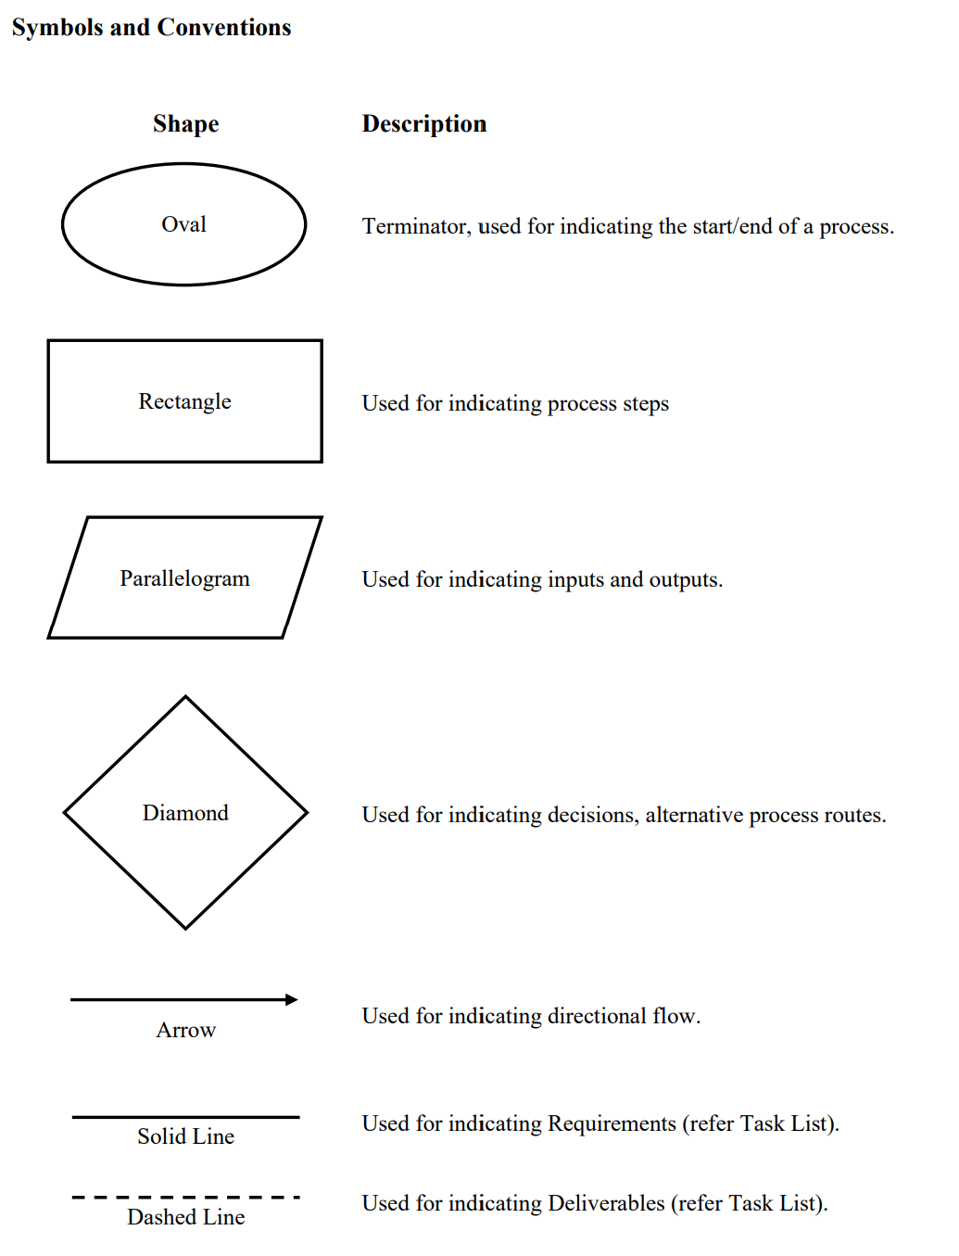
Design Diagrams

Slide 7

Major Project Constraints
Economic and Legal - So far, the plan has been to utilize free-to-use APIs, programming languages and tools. A part of this project will utilize Spotify’s APIs as well as Google Sign-In which are both free to use. However, depending on requirements that may arise in the future, premium versions of these tools may be purchased to accomplish future tasks in the project, if needed. Furthermore, commercialization of the project may require additional purchase of licenses to continue using certain APIs. These funds will be supplied personally.
Technical Knowledge and Time - While I have some experience with the technologies related to the development of this algorithm, one of the biggest constraints for this project is that I have minimal experience with Android development. The project requires the creation of an Android application from scratch. This means that to accomplish all the desired tasks in this project. This means that I may need to spend additional time learning the different technologies associated with Android development and might have additional constraints on what can be accomplished under the limited amount of time.
Diversity and Cultural - Music is heavily influenced and differs by cultural attributes, such as language, and instrumentation. Many musical genres are unique to some geographical region or to an ethnic, religious, or linguistic group. Given the extensive nature of music, its it is not feasible to create a solution that is exhaustive and applicable to all kinds of music. The project, therefore, will most likely be constrained to Western music (in English) with a plan to develop support for one additional language (Spanish) if time permitting.

Slide 8
Review of Project Progress
Phase1: Preliminary Research completed.
Phase 2: Prototyping and Designing under progress.

Slide 9
Expected Accomplishments
Complete Phase 1: Preliminary Research
Make progress in Phase 2: Prototyping and Designing
Research and analyze these algorithms for their performance and user satisfaction.
Determine what works best in each of the algorithms (and if) any ideas can be reutilized for this project.
Determine which parameters are most relevant for defining user preferences in music.
Determine the weightage for each parameter's similarity measure and how to calculate the cumulative similarity.
Determine what framework will be most suitable for developing the android application component.
Design the logo and determine the color scheme for the application.
Curate a list of the top music recommendation algorithms that currently exist.
For each parameter shortlisted, find the best way to measure similarity.

Slide 10
Division of Work
Total Days
248
Total Hours
281
Phase | Days to complete | Hours of Effort
Preliminary Research | 100 | 44
Prototyping and Designing | 21 | 25
Development | 34 | 62
Testing and Verification | 10 | 23
Refining and Debugging | 12 | 24
Validation and Deployment | 20 | 20
Develop Support For Additional Features | 19 | 38

Slide 11

Expected Demo at Expo
Fully functional application which meets all the requirements mentioned in the Task List.
Self-provided Android phone with application downloaded and working on it.

